Slide 1

One2Key
…
“It’s as easy as one, two, key”

Slide 2



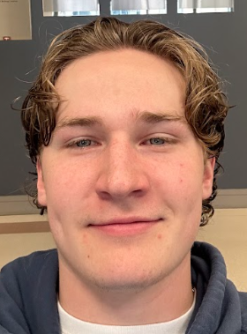

Who we are
Notes:
We don't use power tools/have little knowledge about how to use them. One-Key was confusing to look at and didn't fit the average weekend project user-MATT

Slide 3
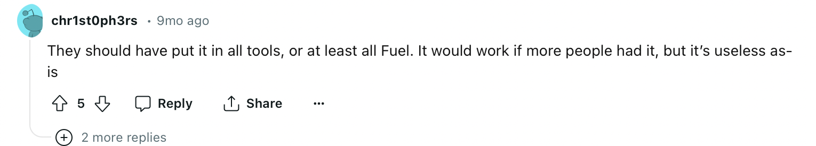
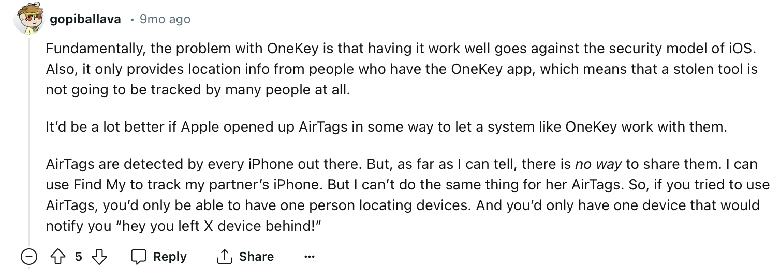
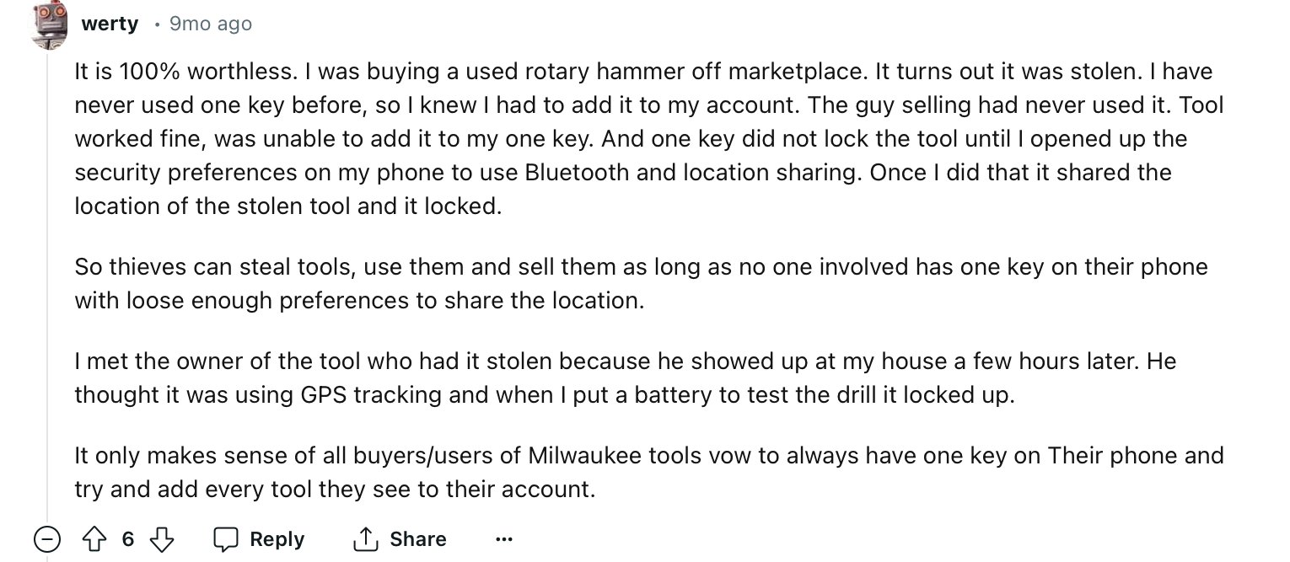
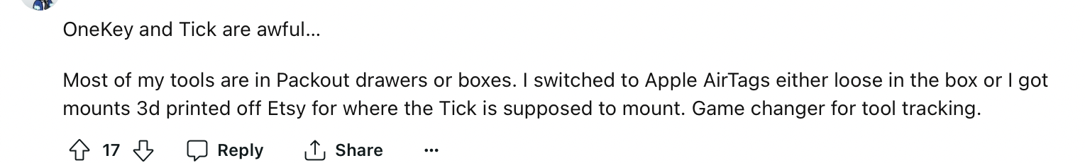
Reviews

Slide 4
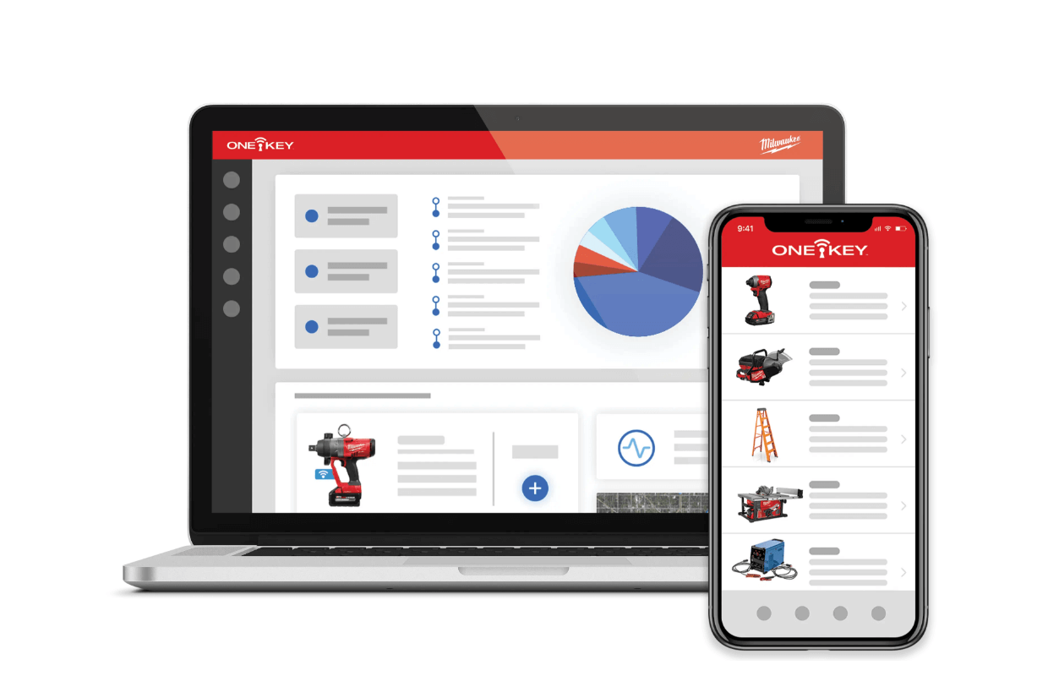
What is the current problem?
Not user-friendly
Battery life
Not cheap
Connection to tools & phones
Chatbot
Notes:
Make problem more concise, why does existing app suck
At home users

Slide 5
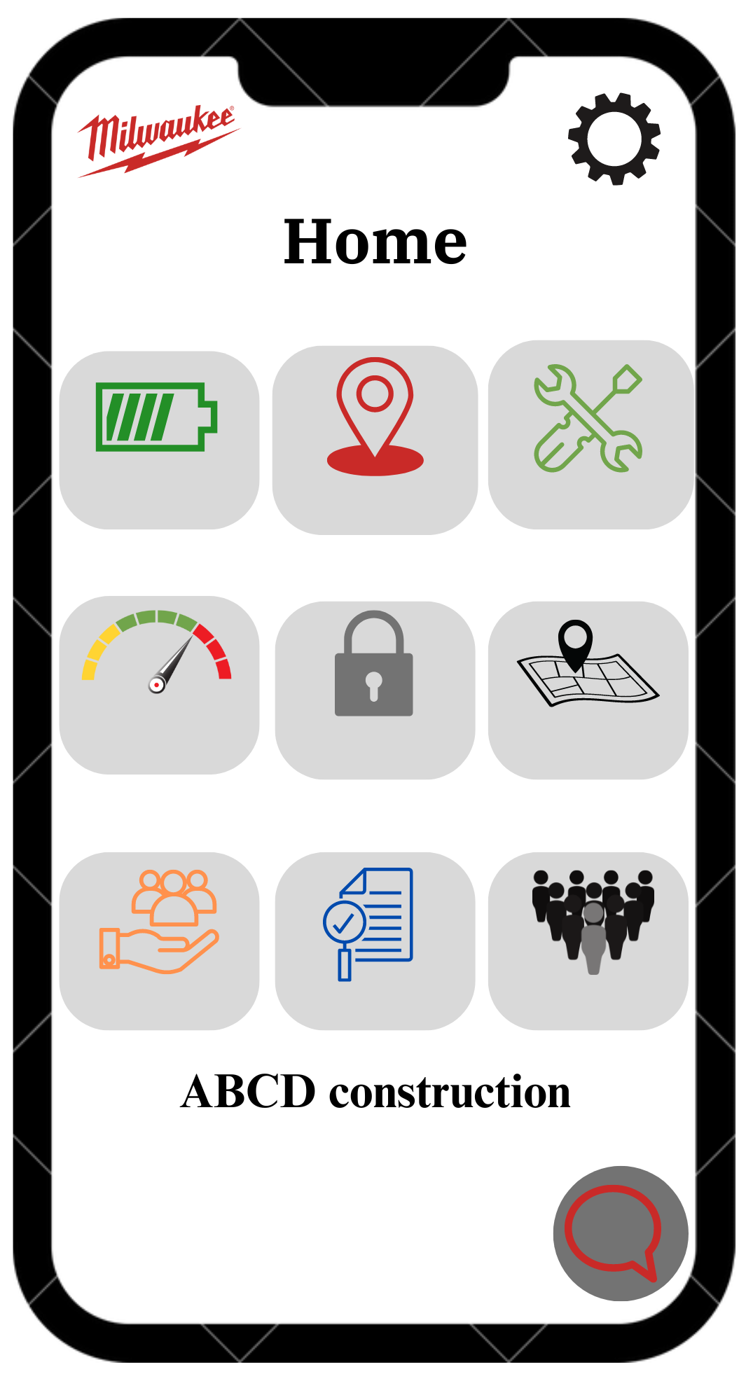
Prototype
Tracking
Maintenance
Battery life*
- shows time of use left on batteries
- time instead of battery percentage
- increased productivity
Tool settings
Repairs*
Tool locking
Projects
Community page*
- Engage with others that use the one2key app, to find new DIY projects
- community members may also help you with problems that you are having
Direct customer care*
Data collection
- 24/7 care service
- quick service
- text, or on the phone

Slide 6
What would we do different?
App focused for at home and DIY users
Make the app as simple and easy for basics users
Battery life tracking
Time till full/dead
Repairs
Nearby stores
Estimated time until replacement
Community Page
Chat for people doing projects
Ideas and tips on how to use the tools
Direct Customer care
24/7 text and call center

Slide 7
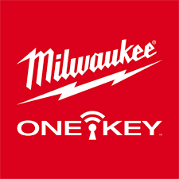
Why would this help?
People want an easier way to access their tools
Improves functionality and appeal of ONE-KEY
At home users
Less technologically advanced (older people)
Simple = less compatibility issues with older phones

Slide 8
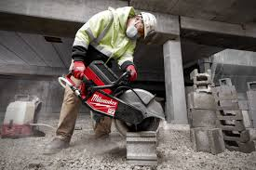
Market Opportunity
Growing the market segmentation of home users
Influence a rising popularity of advanced DIY
Current company target market: Construction professionals
Market segmentation our app enhances: At home users
Notes:
Their target market is geared toward construction companies, contractors, and professionals. They sponsor industry events advertise in trade publications and establish relationships with construction company supply stores. It is time that Milwaukee puts more energy into appealing to at-home users.

Slide 9
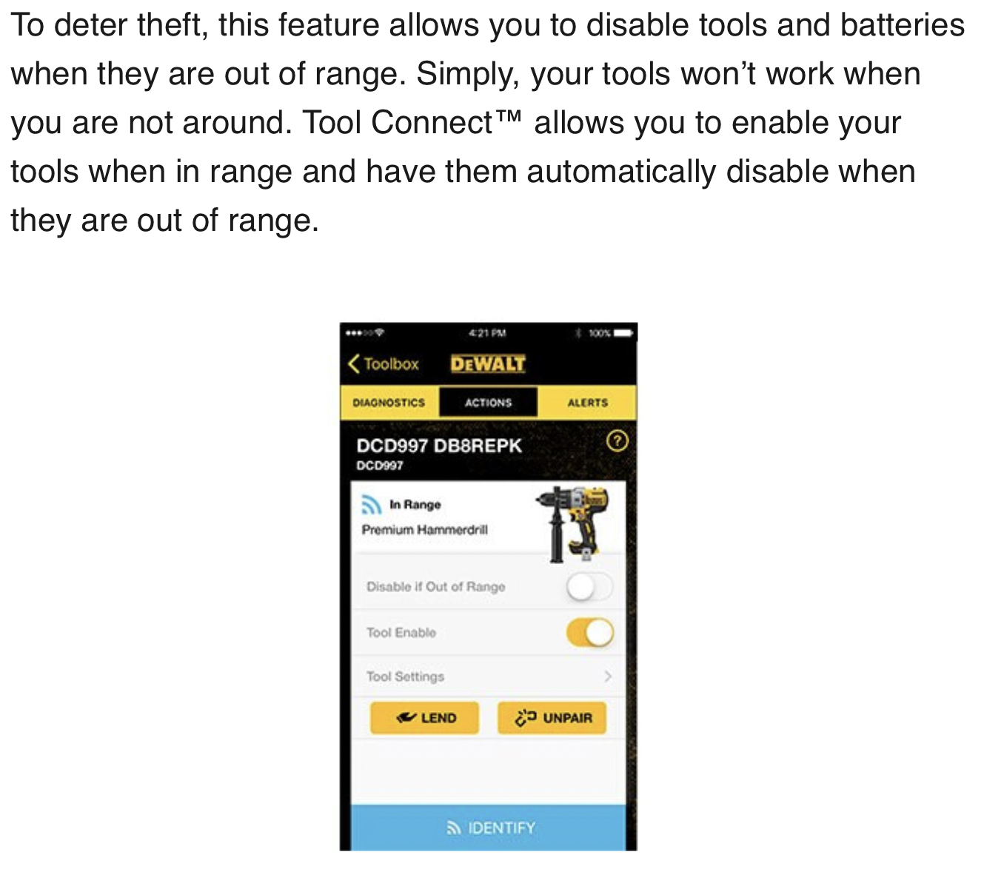
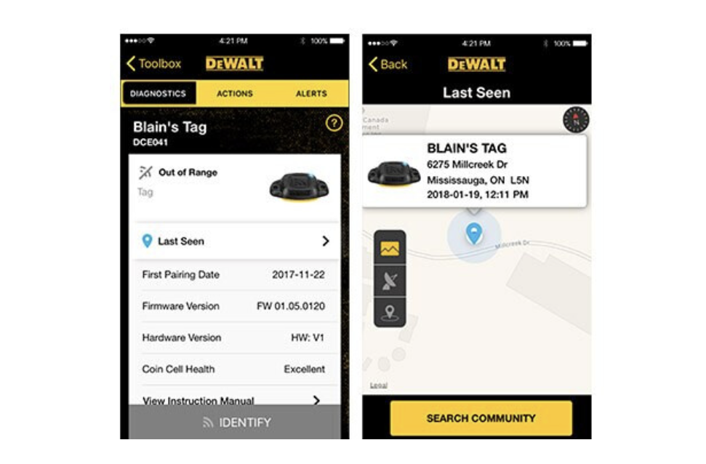
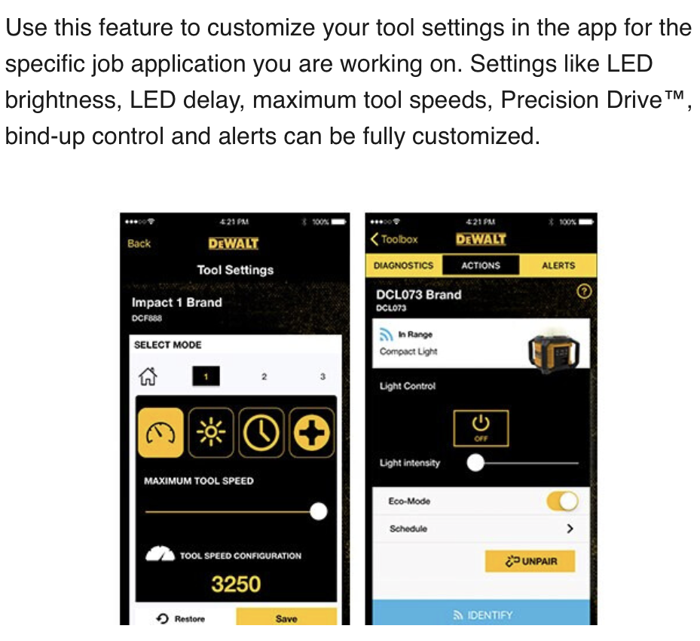
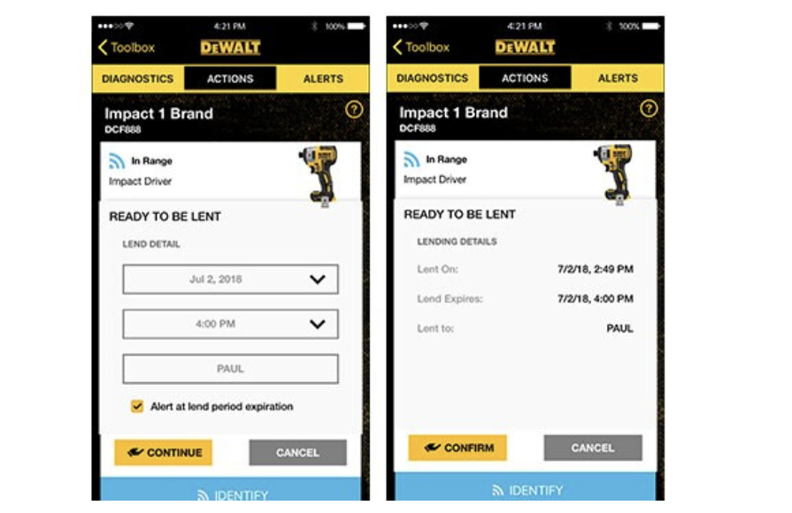
Competition
Dewalt

Slide 10
Expenses
A simple app costs $50,000 to $80,000 to create according to various websites.
yearly costs of updating the app are found to be 20% of the start up cost
Ex. app costs 50,000 to start up, 10,000 will be paid yearly, for all updates
Too expensive!
We found a cheaper alternative
App developers charge any where from $41-$54 an hour, hiring one for the average time to create an app (16 weeks) will cost an estimated amount of $30,000
16 weeks x 5 days a week worked= 80 days x 8 Hrs a day= 640 hours x $47 Avg. hourly rate = $30,080
Same thing can be done to find the lower cost of app updates

Slide 11
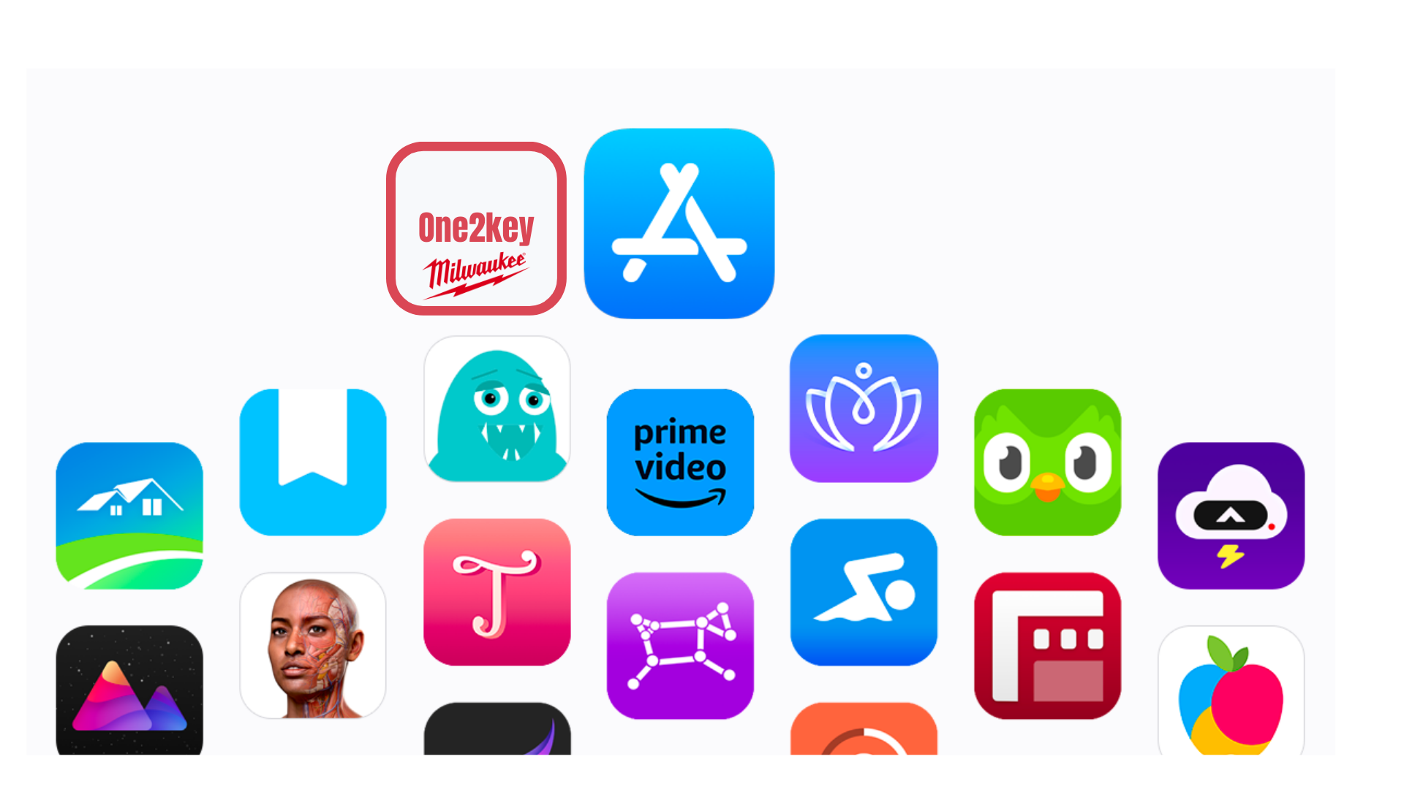
Distribution, awareness and sales
Our app can be found like any other app, it will be released on all mobile app stores.
apple app store, google play, etc.
Aim to create great user experience and customer support services
This encourages word of mouth. Which increases the chances of free promotion
Revenue
revenue won't come from the app, but from customer satisfaction that this app will create.
A growth in customer satisfaction, equals a growth in tool sales.
Satisfaction creates loyal customers that will continue to buy from the company, increasing revenue.

Slide 12
Any questions?

